Slide 1


Slide 2
BIENVENIDOS

Slide 3

Freebibleaiimages.com

Slide 4
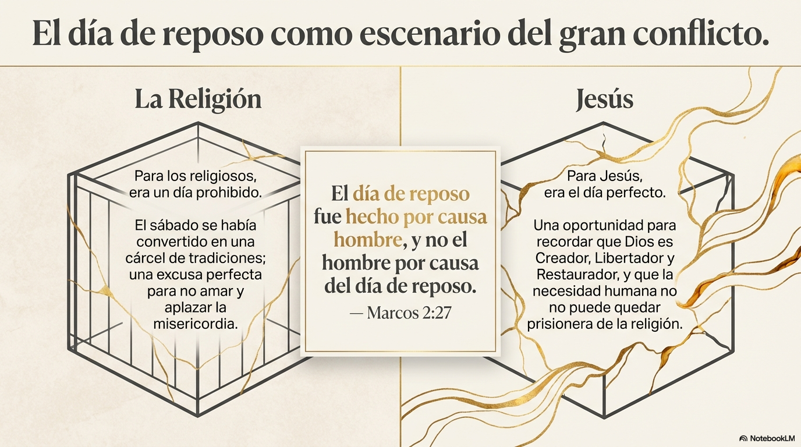
Freebibleaiimages.com

Slide 5
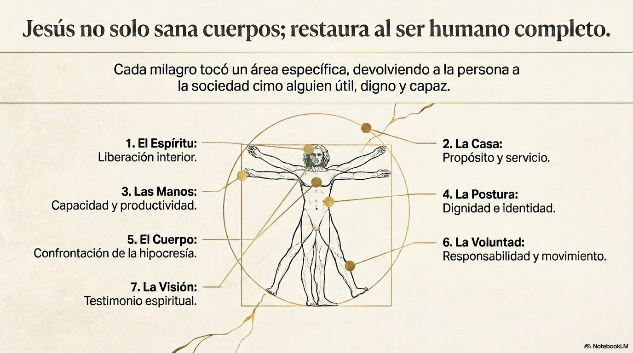
Freebibleaiimages.com

Slide 6

Freebibleaiimages.com

Slide 7
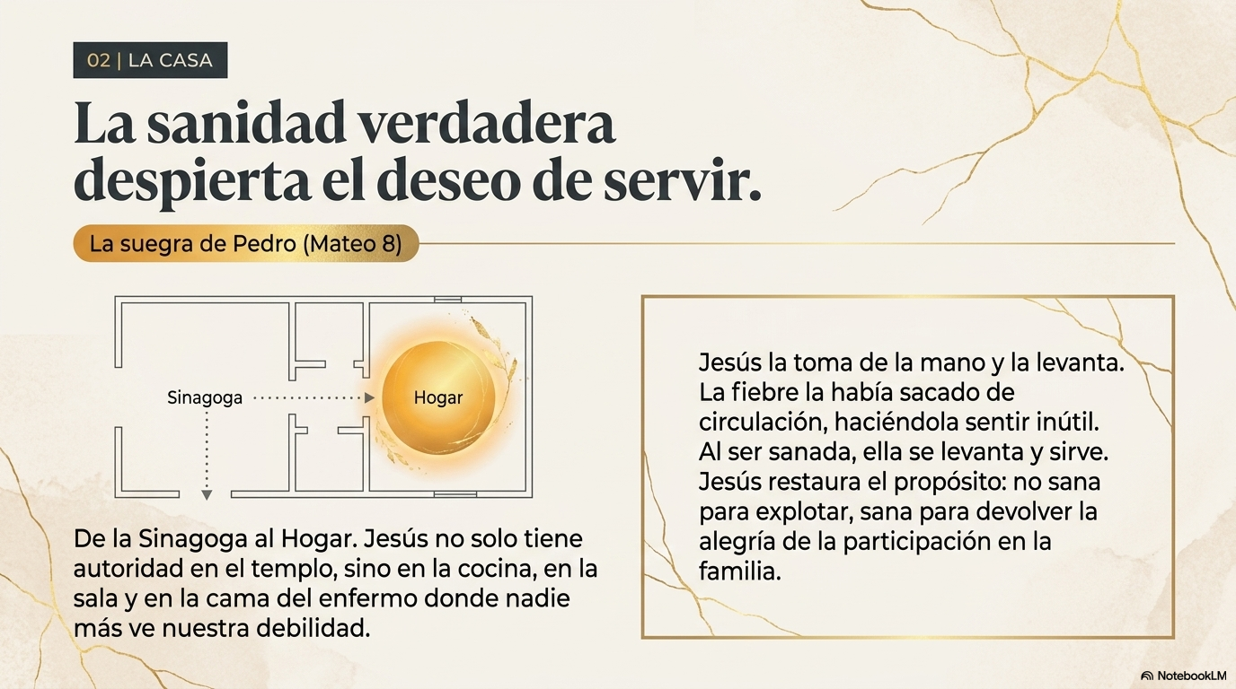
Freebibleaiimages.com

Slide 8
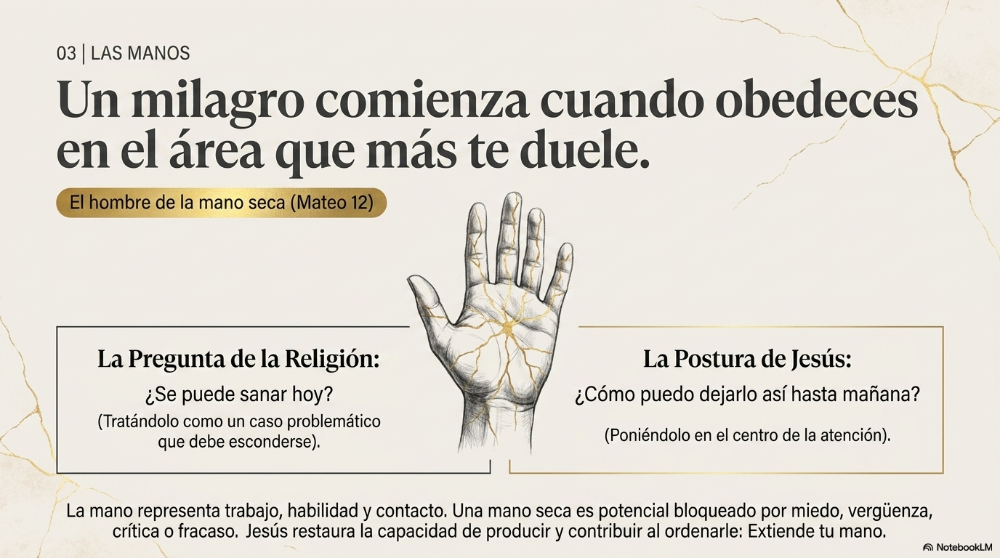
Freebibleaiimages.com

Slide 9
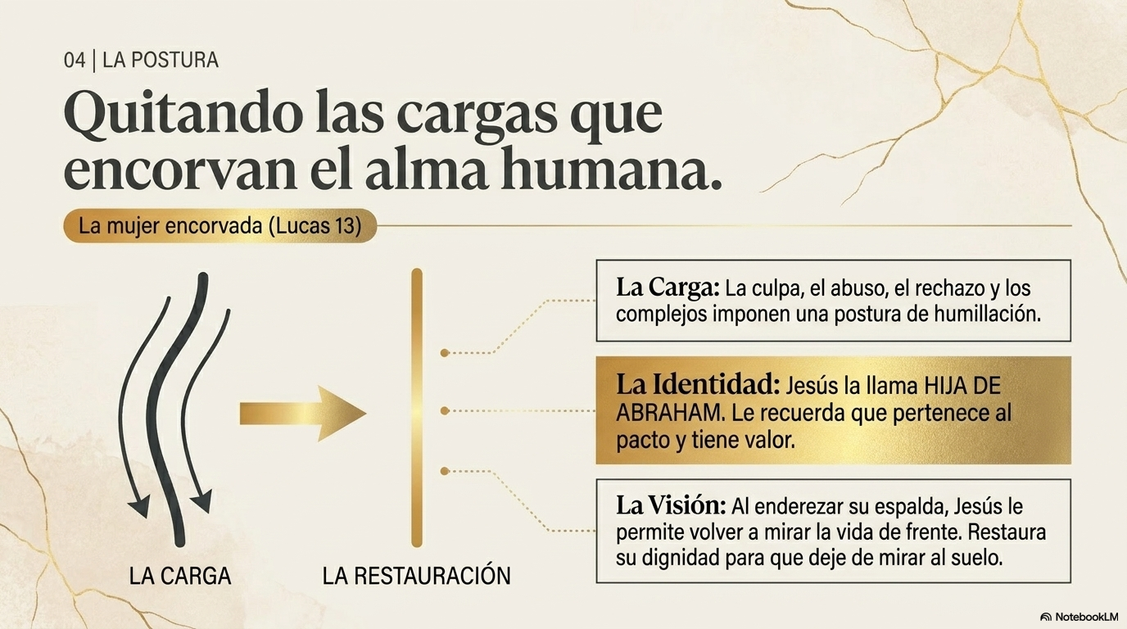
Freebibleaiimages.com

Slide 10
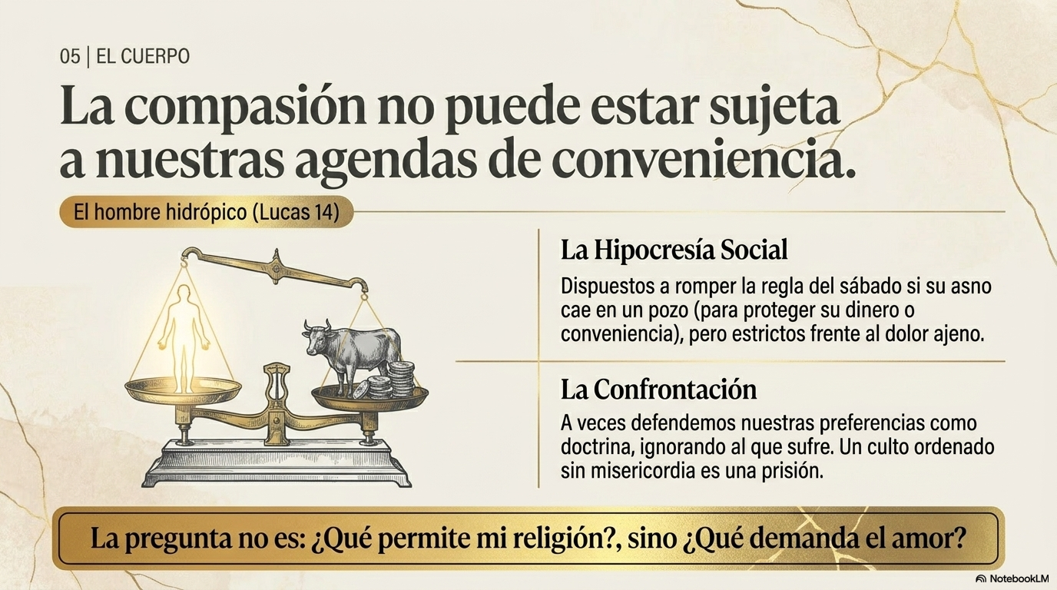
Freebibleaiimages.com

Slide 11
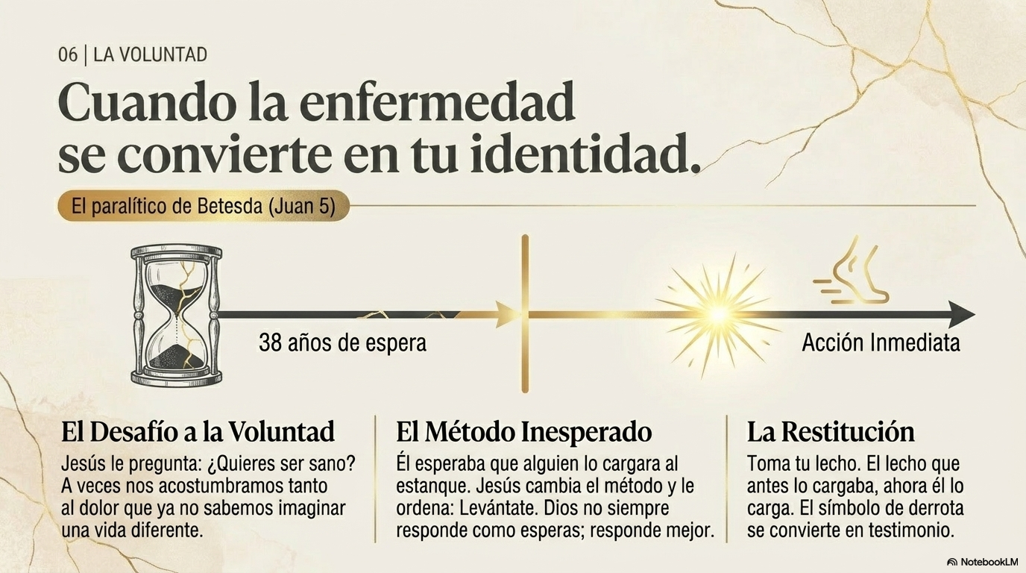
Freebibleaiimages.com

Slide 12
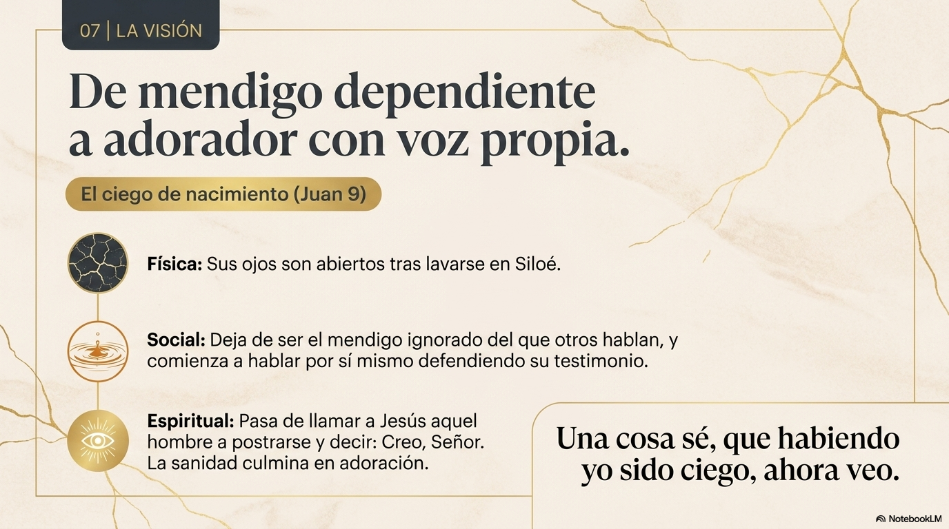
Freebibleaiimages.com

Slide 13

Freebibleaiimages.com

Slide 14
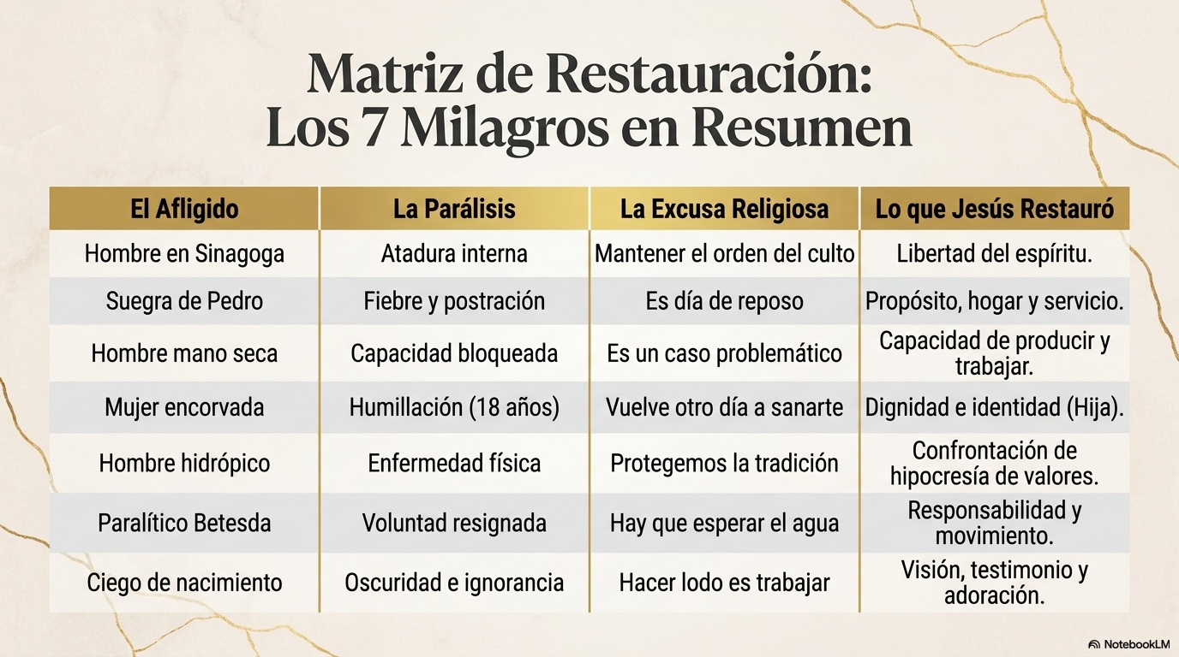
Freebibleaiimages.com

Slide 15

Freebibleaiimages.com

Slide 16
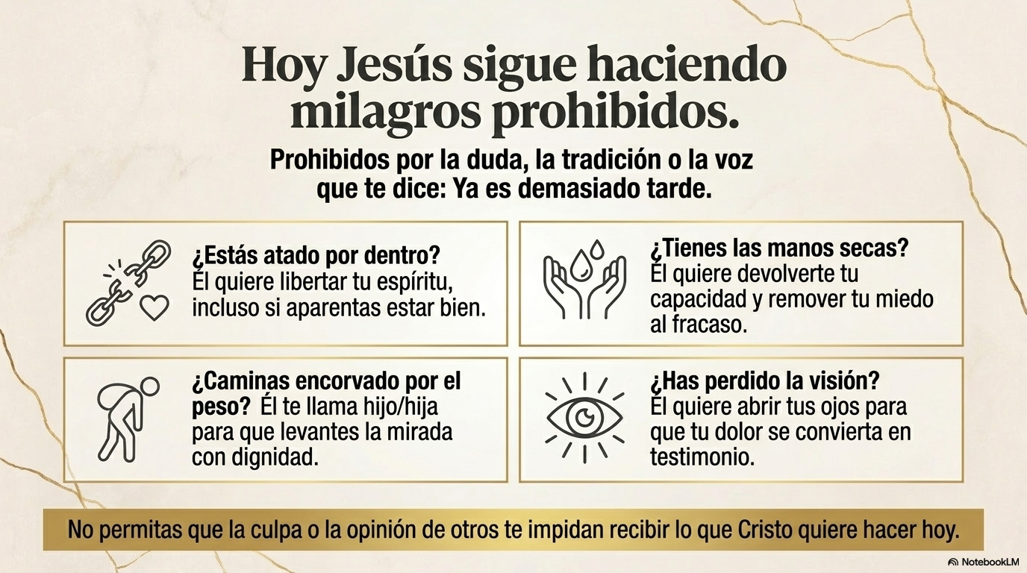
Freebibleaiimages.com

Slide 17
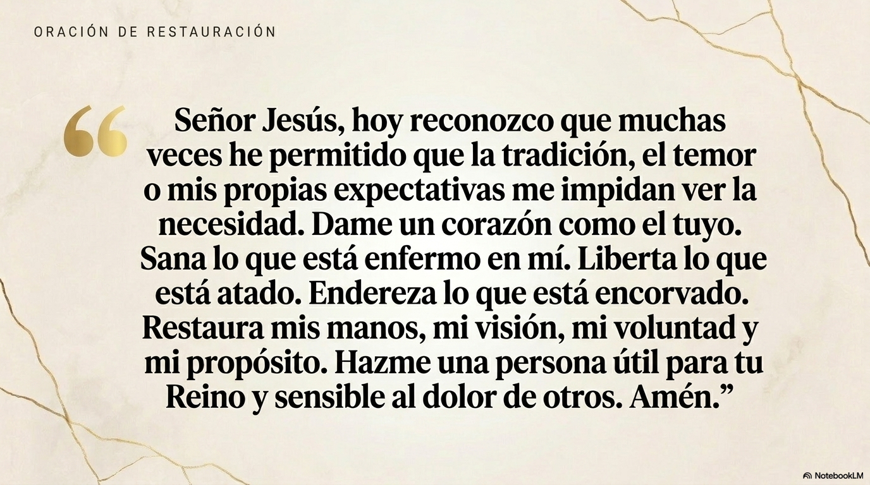
Freebibleaiimages.com

