Slide 1

Christian Apologetics 101
Generated by an initiative of freebibleaiimages.com
canceledgardo@hotmail.com

Slide 2

A Comprehensive Guide to Explaining and Defending our Faith.
Freebibleaiimges.com

Slide 3

Freebibleaiimges.com

Slide 4
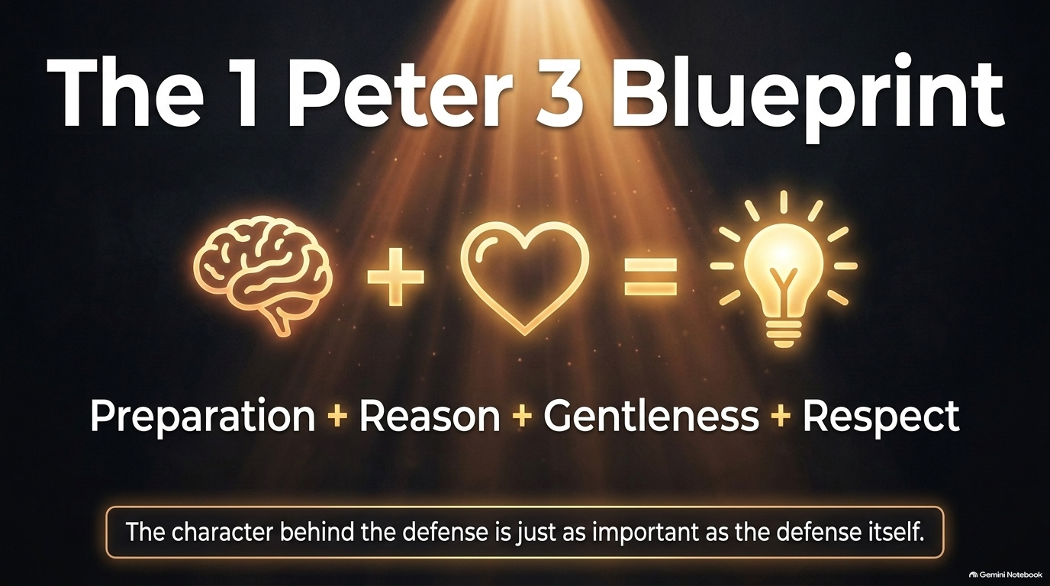
Freebibleaiimges.com

Slide 5

Freebibleaiimges.com

Slide 6
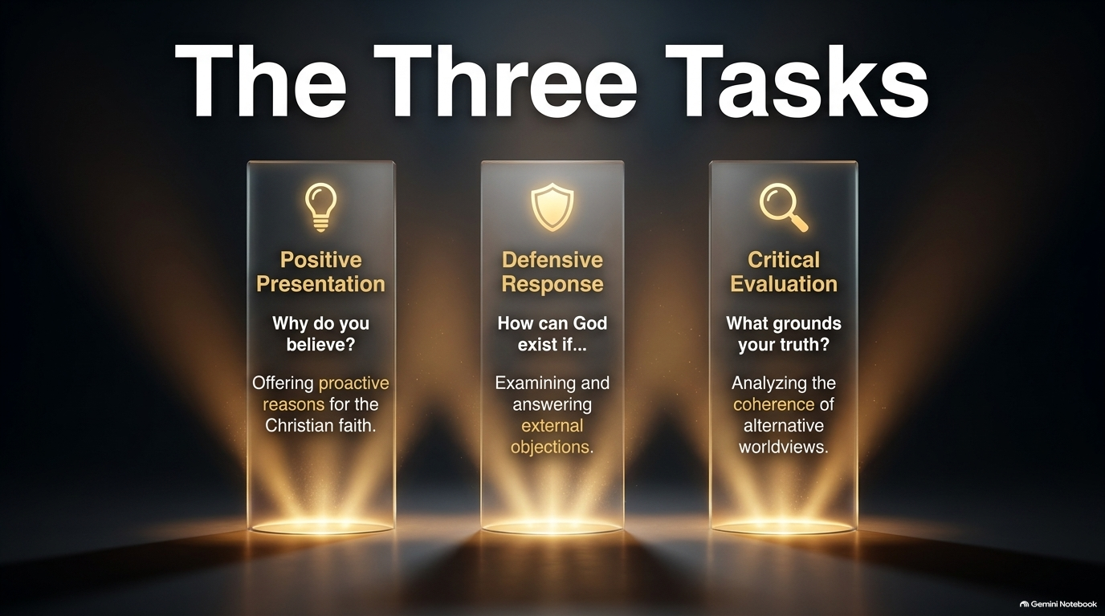
Freebibleaiimges.com

Slide 7

Freebibleaiimges.com

Slide 8
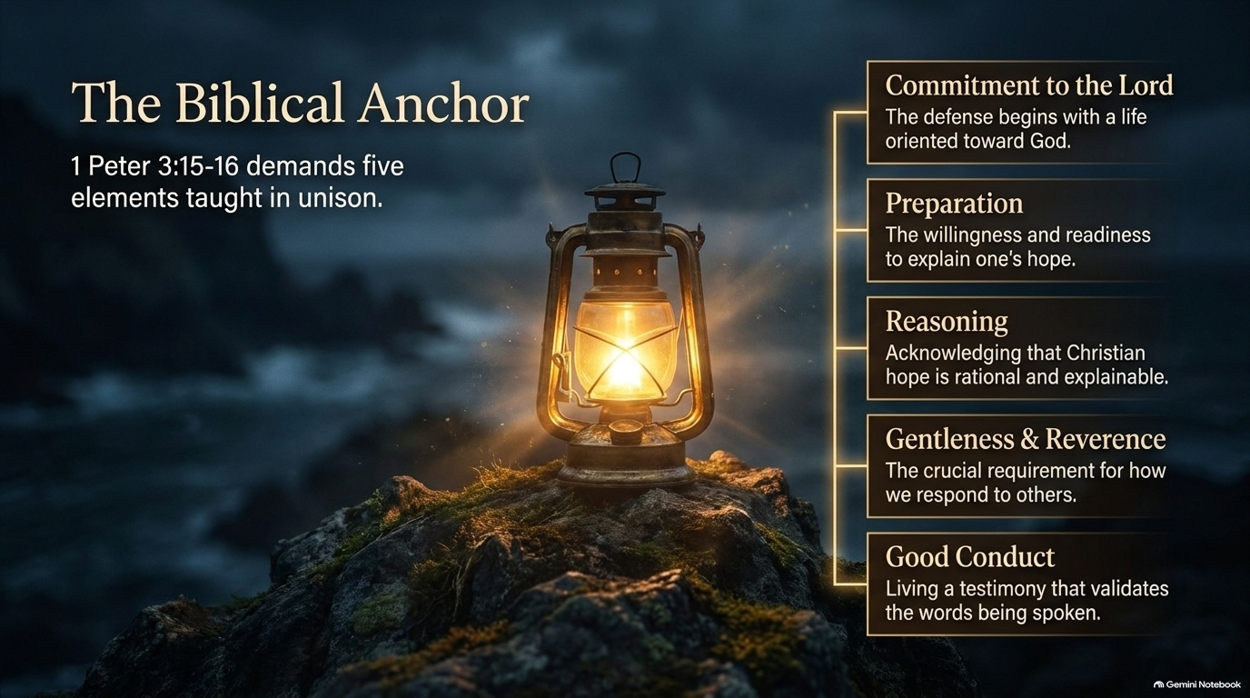
Freebibleaiimges.com

Slide 9
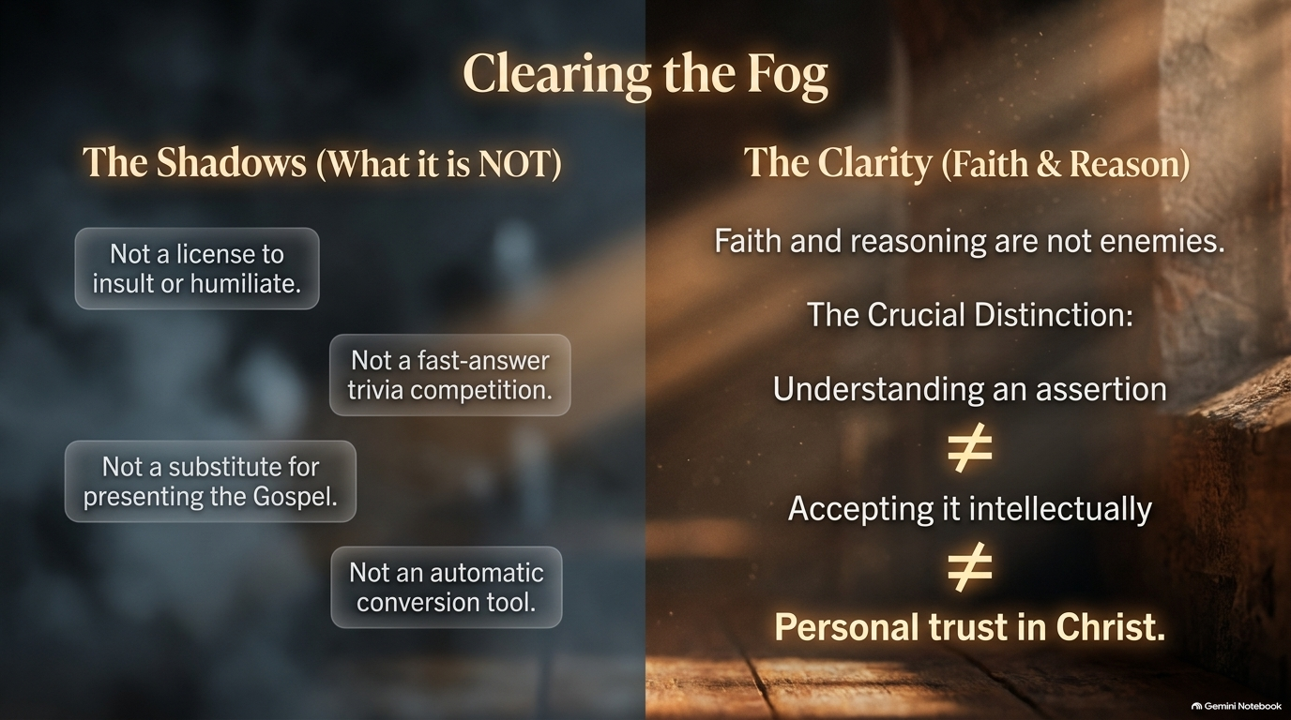
Freebibleaiimges.com

Slide 10
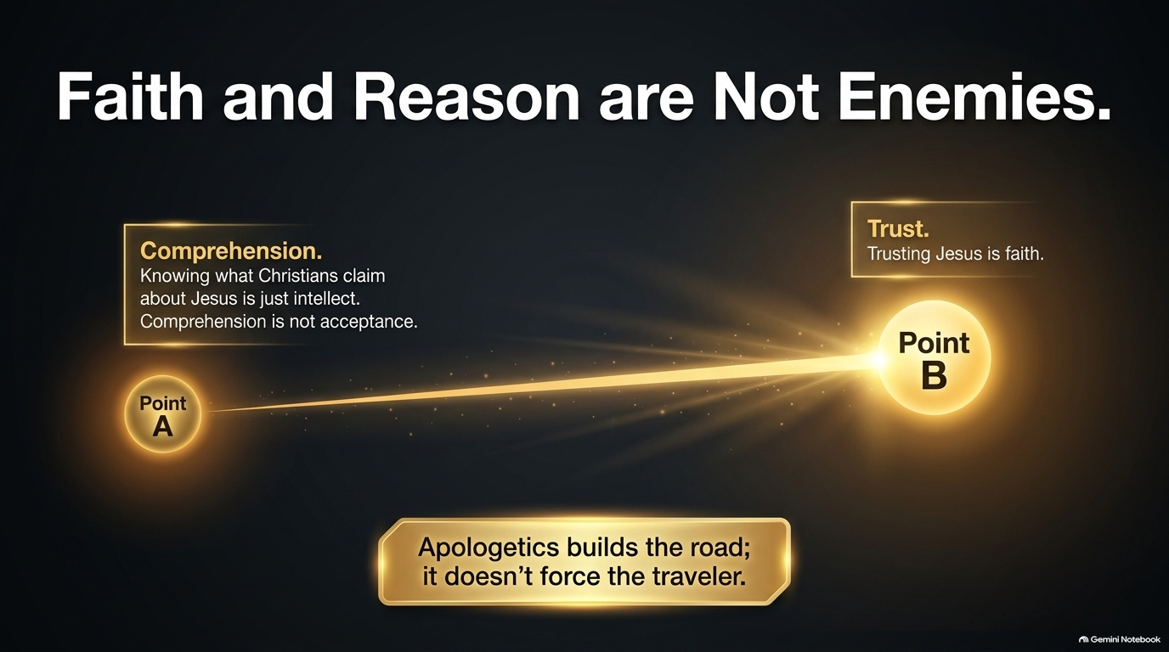
Freebibleaiimges.com

Slide 11
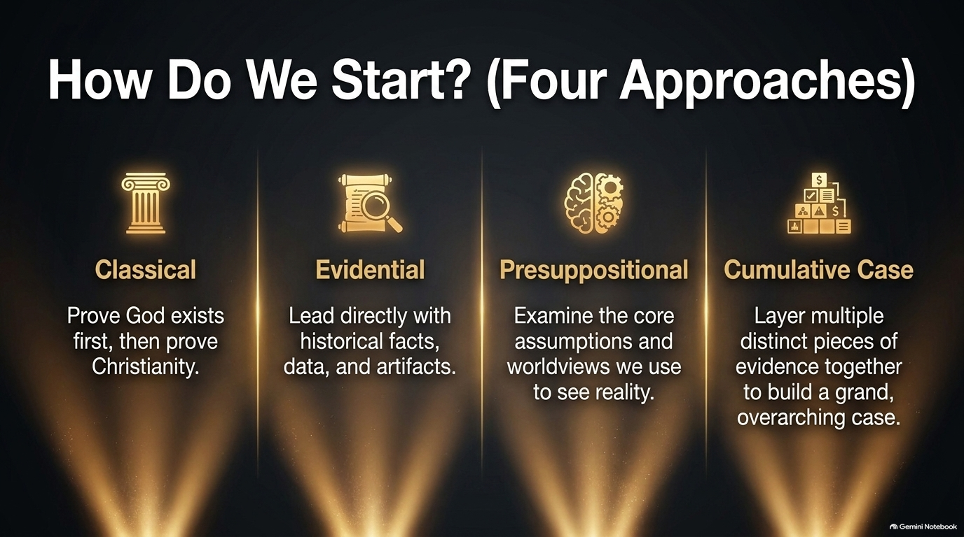
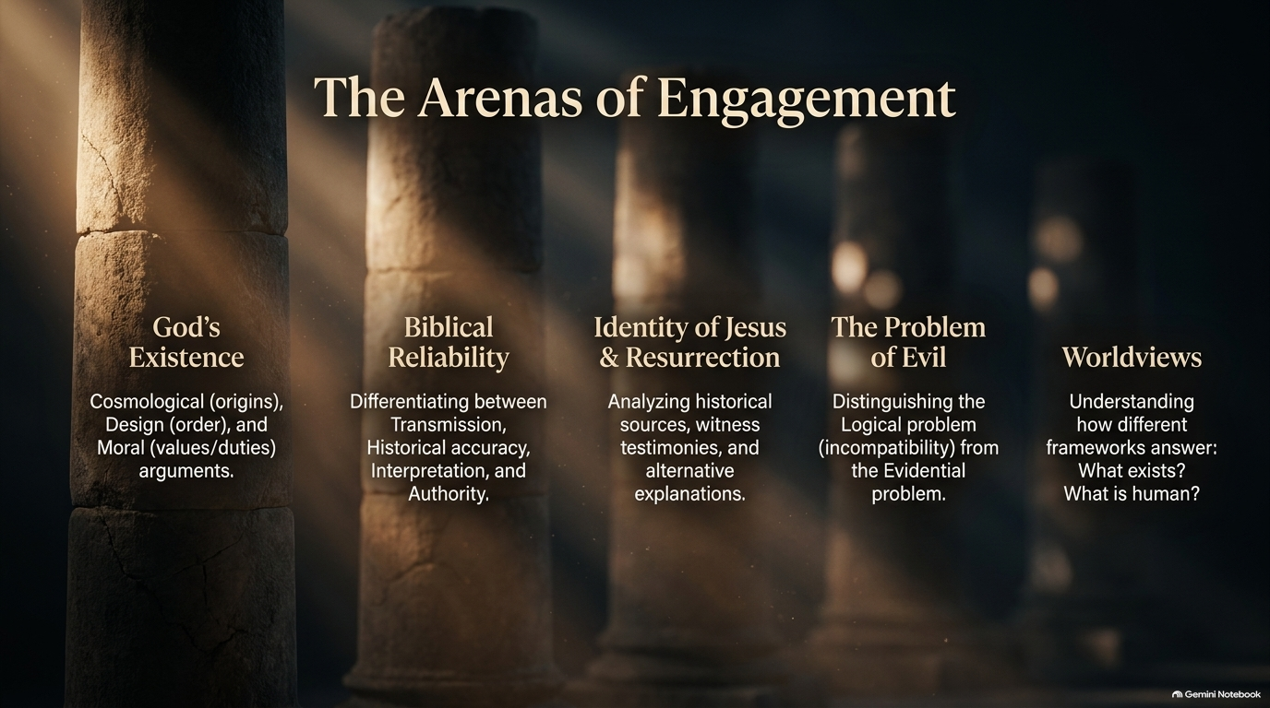
Freebibleaiimges.com

Slide 12
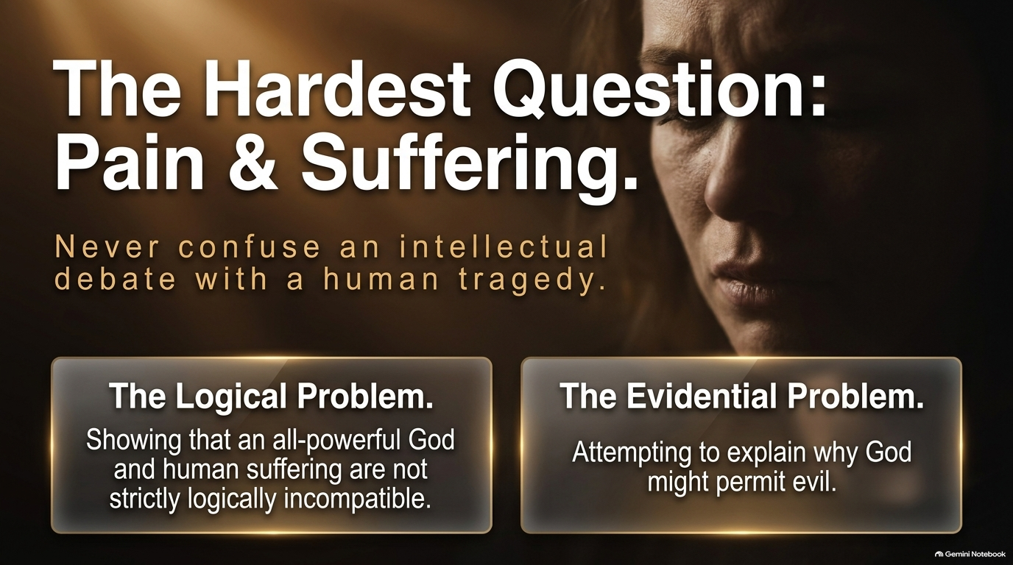
Freebibleaiimges.com

Slide 13
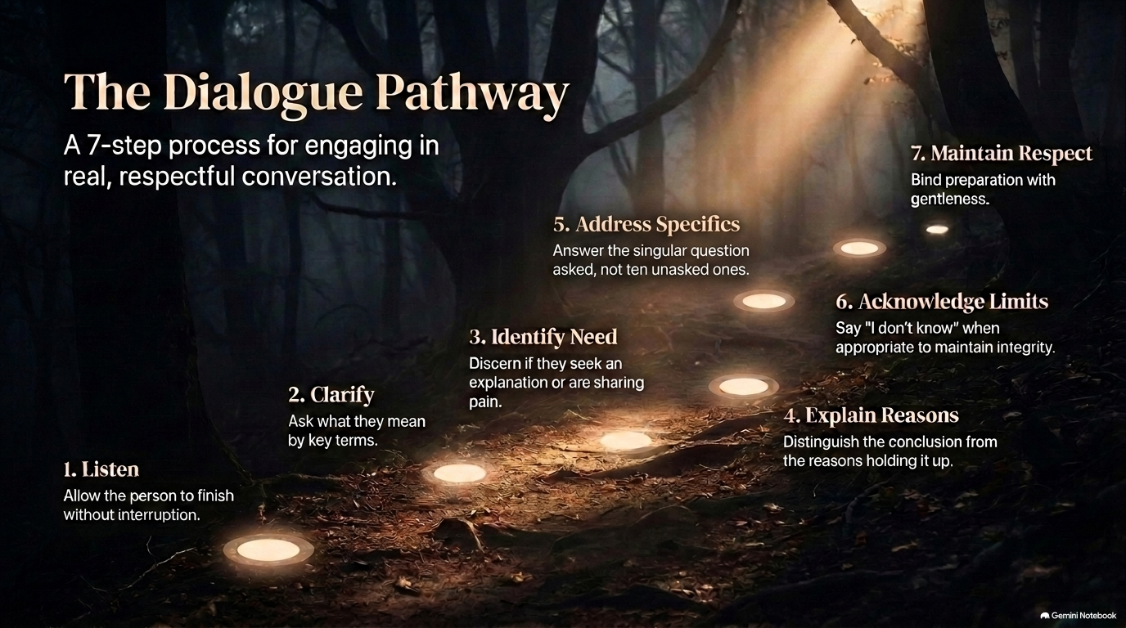
Freebibleaiimges.com

Slide 14
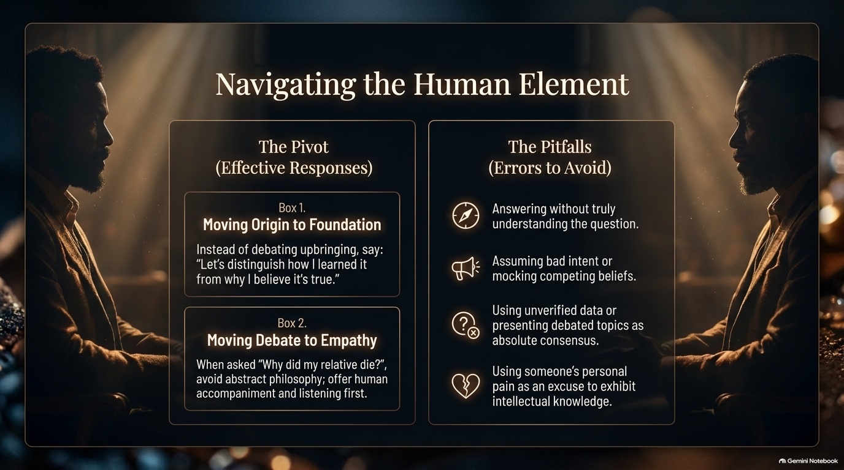
Freebibleaiimges.com

Slide 15
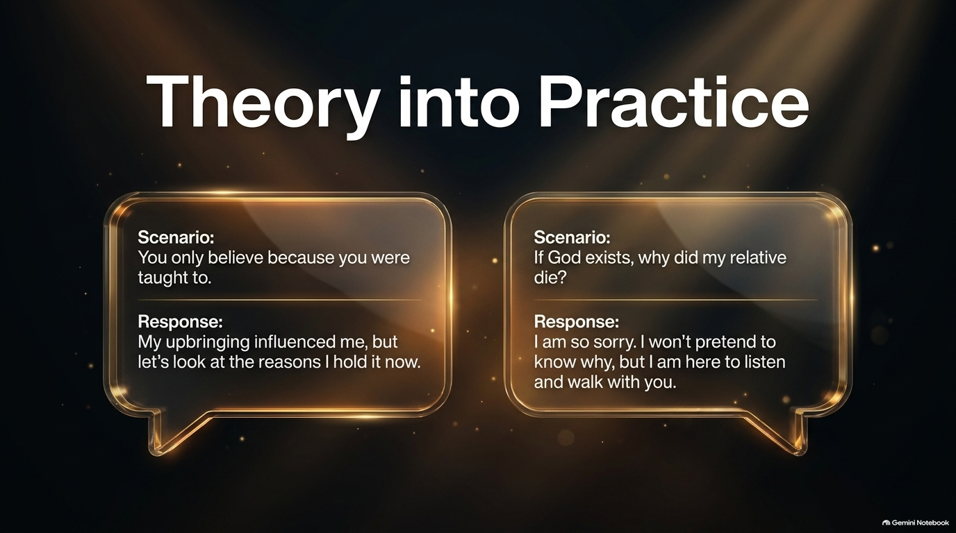
Freebibleaiimges.com

Slide 16
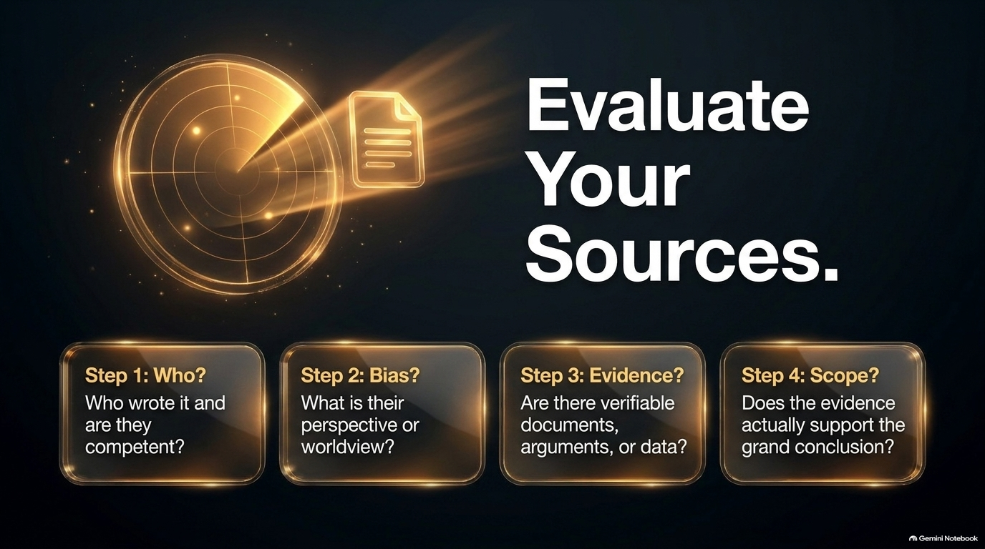
Freebibleaiimges.com

Slide 17
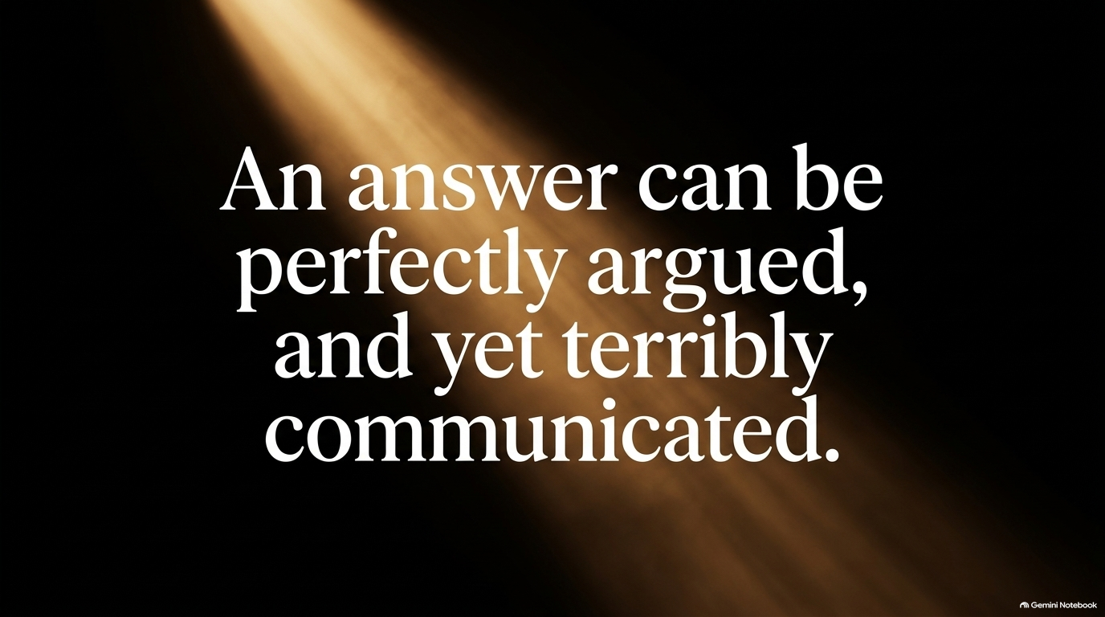
Freebibleaiimges.com

Slide 18

Freebibleaiimges.com

Slide 19

Freebibleaiimges.com

Slide 20
Christian Apologetics 101
Generated by an initiative of freebibleaiimages.com
canceledgardo@hotmail.com

